Slide 1

CSS Grid vs Flexbox
By Alex Joslin

Slide 2
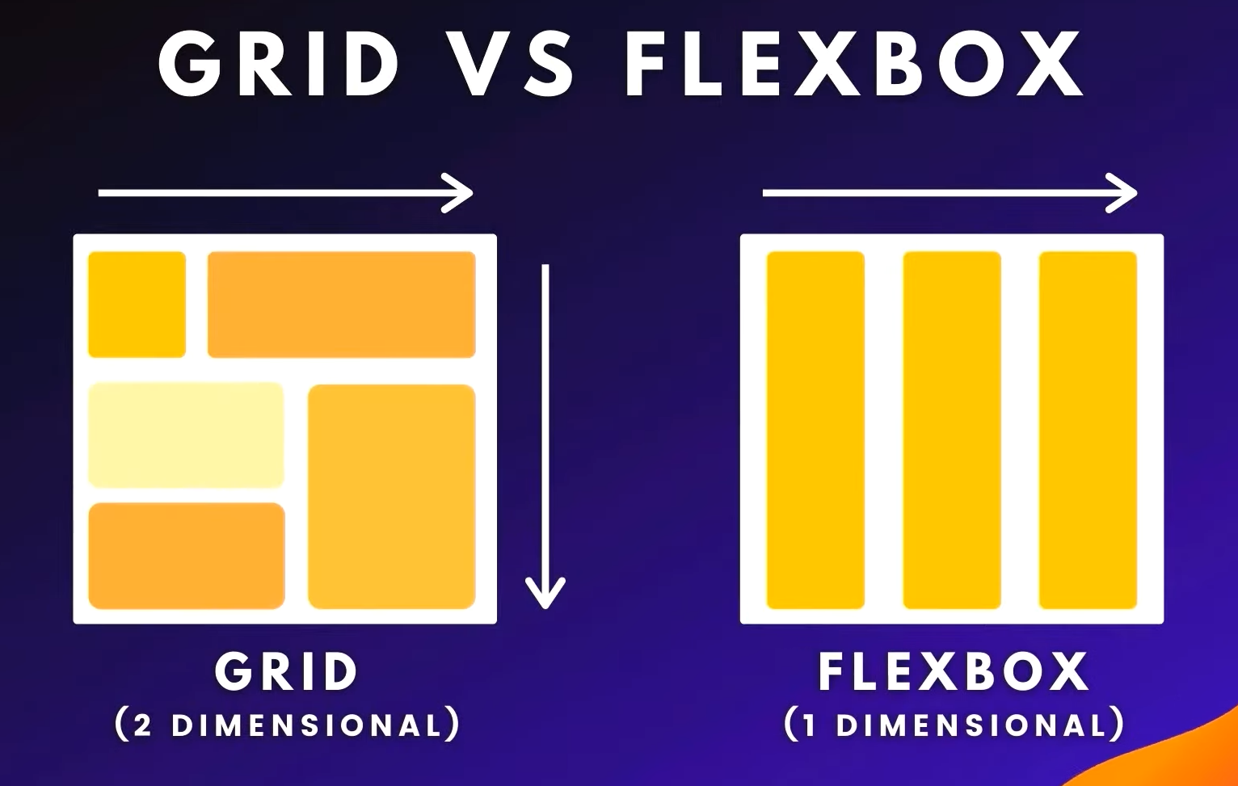

Slide 3
Grid

Slide 4
Flexbox

Slide 5
GRID
Flexbox
2-dimensional system
Control over how content is laid out vertically and horizontally.
Great for strictly defining a layout for your website.
Great for precisely placing item in cells defined by rows and columns.
Can overlap items.
Layout shapes content.
1-dimensional system
Must either have a column or row-based layout.
Browser only calculates where to place items in 1 direction.
Great for aligning content in one direction and moving blocks.
Content shapes layout.

Slide 6
Guides for Grid & Flexbox
Grid
https://css-tricks.com/snippets/css/complete-guide-grid/
Flexbox
https://css-tricks.com/snippets/css/a-guide-to-flexbox/

